Slide 1
Cost of Software Quality (CoSQ)
Instructor
Iqra Rafique
Lecturer
iqrarafique@cuilahore.edu.pk

Slide 2
The Classic Model of Cost for Software Quality
The Classic Model is based on the principles of quality costs introduced by Joseph Juran and Philip Crosby. It categorizes the costs associated with software quality into four main components:
Prevention Costs
Appraisal Costs
Internal Failure Costs
External Failure Costs

Slide 3
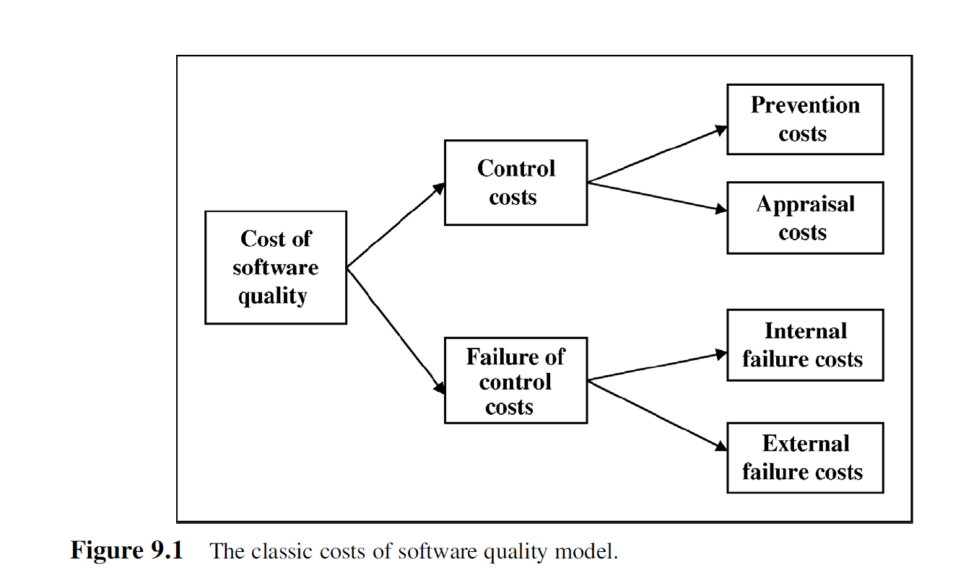
The Classic Model of Cost for Software Quality

Slide 4
Prevention Costs
These are costs incurred to prevent defects from occurring in the first place.
Examples:
  Training for developers and testers.
  Process improvement initiatives.
  Quality planning and requirements analysis.
  Design reviews and code inspections.

Slide 5
Appraisal Costs
These are costs associated with evaluating the quality of the software.
Examples:
  Testing activities (unit testing, integration testing, system testing).
  Quality audits and reviews.
  Static and dynamic analysis tools.

Slide 6
Internal Failure Costs
These are costs incurred when defects are found before the software is delivered to the customer.
Examples:
  Debugging and rework.
  Retesting after fixes.
  Delays in the development process due to defects.

Slide 7
External Failure Costs
These are costs incurred when defects are found after the software is delivered to the customer.
Examples:
  Customer support and hotfixes.
  Warranty claims and liability costs.
  Loss of reputation and customer trust.

Slide 8
The Extended Model for Cost of Software Quality
The Extended Model builds on the Classic Model by incorporating additional dimensions and considerations that are particularly relevant to software development. This model recognizes the unique characteristics of software, such as its intangible nature, complexity, and the importance of maintenance.
a. Additional Cost Categories
The Extended Model introduces new cost categories or refines existing ones to better reflect the realities of software development:

Slide 9
Indirect Costs
Costs that are not directly tied to quality activities but are influenced by them.
  Productivity losses due to poor quality.
  Example: Developers spend several days fixing bugs instead of developing new features, reducing overall productivity.
  Opportunity costs from delayed releases.
  Example: A shopping app launch is delayed due to software defects, causing the company to miss potential sales during a major shopping event.

Slide 10
Lifecycle Costs
Costs incurred throughout the software lifecycle, including maintenance and evolution.
Examples:
Post-release bug fixes.
Fixing a login error discovered by users after the software has been released.
Updates and enhancements.
Adding a password recovery feature and improving the user interface in an existing application.

Slide 11
Intangible Costs
Costs that are difficult to quantify but have a significant impact.
Examples:
  Loss of customer goodwill.
  Damage to brand reputation.

Slide 12
Broader Perspective on Quality
The Extended Model emphasizes that quality costs should be viewed from a broader perspective, considering:
Stakeholder Impact: How quality issues affect customers, users, and other stakeholders.
Long-Term Consequences: The impact of quality decisions on the software's lifecycle and sustainability.
Organizational Culture: The role of organizational culture in promoting or hindering quality.

Slide 13
Dynamic Nature of Software Quality Costs
The Extended Model acknowledges that software quality costs are not static. They evolve over time due to factors such as:
Changes in technology.
Shifts in customer expectations.
Improvements in development practices.

Slide 14
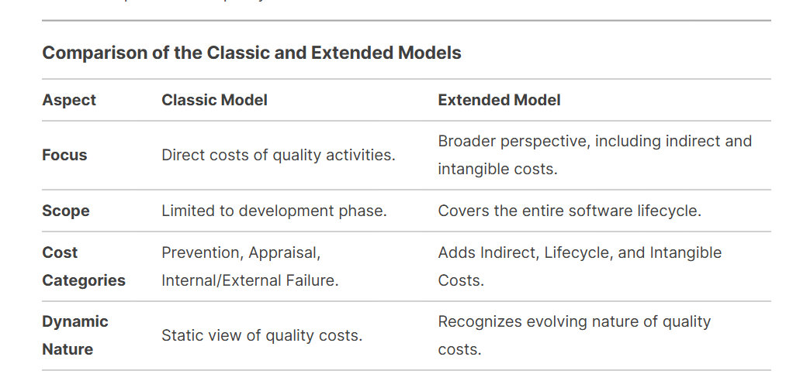
Comparison of the Classic and Extended Models

